Slide 1

Memorizing the
Amendments:
Made Easy
Grouped by: Britany Stergos!

Slide 2
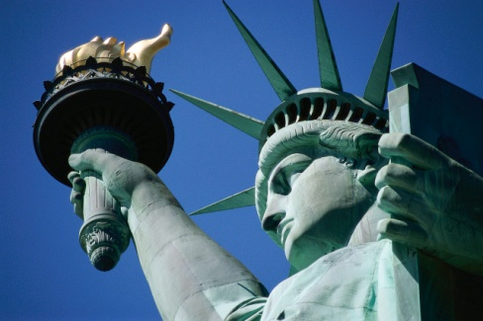
Personal Liberties
Amendments: 1, 2, 9, 10, 14
  #1: Freedoms: of religion, press, speech, assembly, and petition, no establishment of an official religion or prohibiting free exercise of (separation of church and state).
  #2: Arms: Right to keep and bear arms
  #9: Enumerated rights: Guarantee that rights not enumerated (listed) in the Constitution are still protected and retained by the people
  #10: Reserved rights: Guarantee that the people and the states have all of the powers not specifically delegated the federal government (reserved powers)
  #14: Equal Protection under law:
    Declares that all citizens are guaranteed equal treatment and protection under the law (due process) / no state can deny rights
    Bars former Confederates from holding office
    Declares Confederate debt null and void

Slide 3

Rights of the Accused
Amendments: 5,6,7,8
  #5: R.O.A:
    Accused must be indicted by a Grand Jury
    Cannot be tried for the same crime twice (double jeopardy)
    Cannot be forced to testify against yourself
    Right to a fair trial with all proper legal rights enforced (due process)
    Right to fair compensation ($$) when the Gov't takes your property for public use. (eminent domain)
  #6: More R.O.A:
    Right to be informed of the charges against you
    Right to a trial where committed crime
    Right to a speedy and public trial
    Right to an impartial jury
    Right to face witnesses against you in court
    Right to counsel (a lawyer)
    Right to call witnesses in your defense

Slide 4
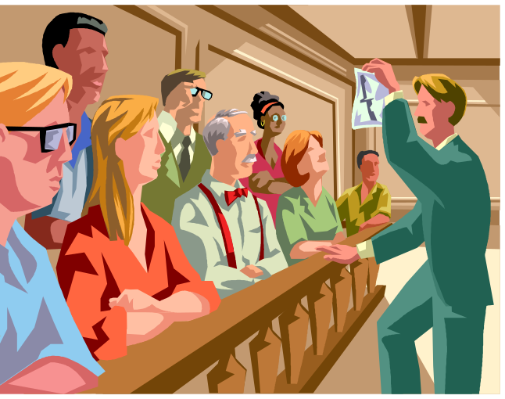
Rights of Accused continued:
  #7: Rights in civil cases:
    Right to a trial by jury in a civil case (non-criminal case) if exceeds twenty dollars
  #8: Cruel and unusual punishment:
    Right to protection against cruel and unusual punishment
    Right to protection against ails and excessive fines and bail

Slide 5


Policing
Amendments: 3, 4, *see 8
  #3: Quartering:
    Right to protection from troops being quartered in homes during peacetime.
  #4: Search & Seizure:
    Right against unreasonable search and seizure (persons, houses,& papers)
    Warrants require probable cause and must be specific

Slide 6

VOTING
Amendments: 15, 17, 19, 23, *24, 26
  #15: Right to Vote: Insures black males the right to vote
  #17: Direct Election of Senators: Senators are to be elected by the people
  # 19: Women’s Suffrage: Women are granted the right to vote
  #23: Voting in D.C: Grants Washington D.C. 3 electors to the electoral college
  #24: Abolition of Poll Taxes: *Also in taxing/regulation
    Poll taxes are illegal in federal elections
  #26: Voting Age: The age of eligibility for voting is lowered to 18

Slide 7

Presidential/Executive Rights
Amendments: 12, 20, 22, 25
  # 12: Election of President and V.P:
    Electors to the Electoral College are to cast one vote for President and separate vote for Vice President
    The House elects the President if no candidate gets an electoral majority (each state w/ 1 vote)
    The Senate elects the Vice President of no candidate gets an electoral majority
    President and VP run on a ticket

Slide 8
Continued:
  # 20: Lame Duck and Presidential Inauguration:
  Who takes office if Pres. or VP isn’t qualified or dies
  President and Vice President are sworn into office on Jan. 20th (moved from March 4th)
  Congress once a year Jan. 3rd
  #22 Presidential Term Limits:
    No person may serve as President more than twice - [but don’t forget vices can serve 2 years of the president’s term they succeeded, while still running twice]
#25: Presidential Succession:
  Establishes a clearer succession to the presidency and vice presidency

Slide 9
Presidential Rights continued
#25: Presidential Disability & Vacancies / Succession:
  What happens if a Pres. Dies
  What happens if a Pres. Cannot perform their duties / notifies Congress in writing
  If the VP and the Cabinet or Congress say he is still “unable to perform” The Congress decides in 48 hours
  If a vacancy in VP Pres. Nominates one and Congress approves (maj. vote)
  Establishes a clearer succession to the presidency and vice presidency

Slide 10
Taxing and Regulation
Amendments: 16, 18, 21, 24
  #16: Income Tax:
    Grants Congress the power to collect taxes on income
    Money collected does not have to be reapportioned to states based on population
  #18: Prohibition:
    The sale, manufacturing, transportation, or importation of alcohol is illegal
  #21: Repeal of Prohibition:
    The 18th amendment (prohibition) is repealed
    Alcohol is again legal
  #24: Abolition of Poll Taxes:
    Poll taxes are illegal in federal elections

Slide 11
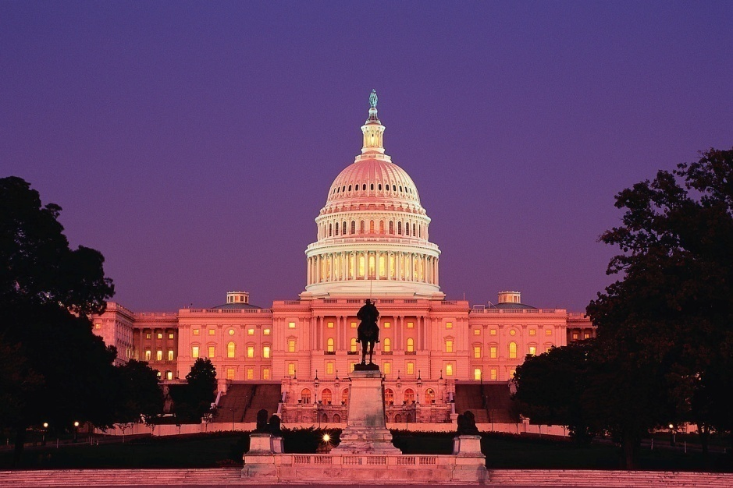
Congress
Amendments: 17, 27
  #17: Direct Election of Senators:
    Senators are to be elected by the people (state will fill vacancies
  #27: Congressional Pay Raises:
    Congressional pay raises do not take effect until after the next Congressional election

Slide 12
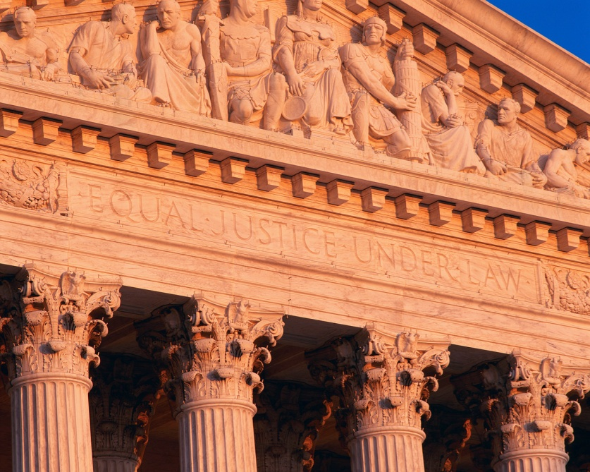
States Rights
Amendment: 11
  #11: State Immunity:
    Limits the ability of a person to sue a state
    Allows a person to sue if a state denies their rights
    * see #10

Slide 13

S L A V E R Y
Amendment: 13
  #13: Abolition of Slavery:
    Slavery is illegal.
    Remember the 13th,14th and
    15th amendments deal
    with the freed African-
    Americans

